Slide 1
Corona Travel
Data design

Slide 2
Product description
Our goal is to allow users to travel online from home via any device of their liking. They'll start by opening an app or a link and choosing a desired destination. After choosing a location, users can choose to view destination in 3D, look at some 3D photos or videos or learn some facts about the place.
Team: Sofya Donskaya, system analyst; Elena Karelina, backend developer; Danil Kireev, frontend developer; Artem Filimonov, backend developer + API integrator
Repo: https://github.com/randomunrandom/corona_travel
Report: https://docs.google.com/presentation/d/1h8Zk4FNvIv73qRzUFzExyZpHQdcteYb4myk55FeZw-M/edit?usp=sharing

Slide 3
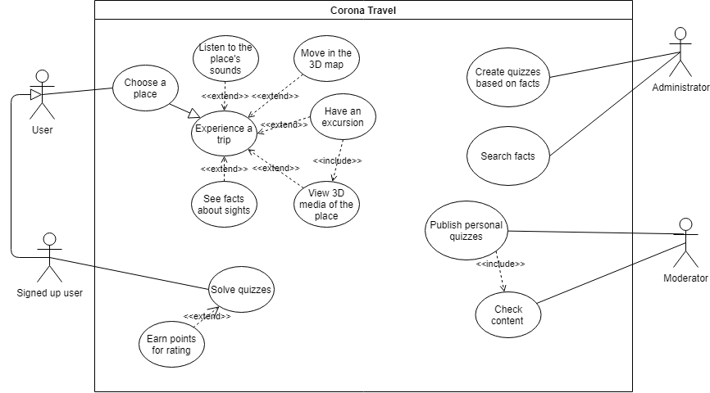
Use case diagram
Scenarios: https://github.com/randomunrandom/corona_travel/wiki/Scenarios

Slide 4
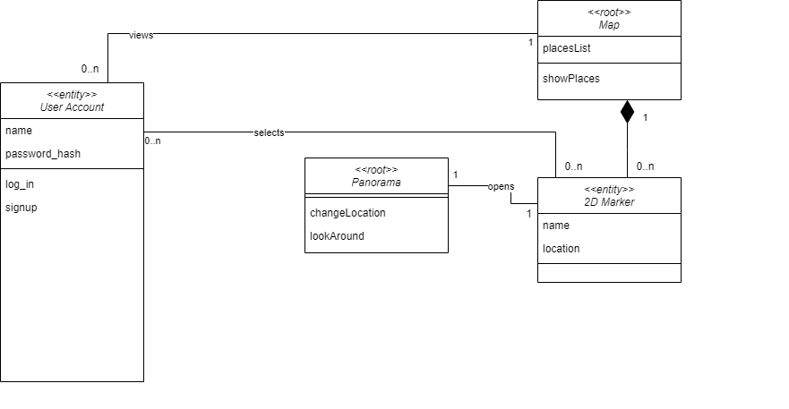
Logical data model - Class diagram for 2D Map Service

Slide 5
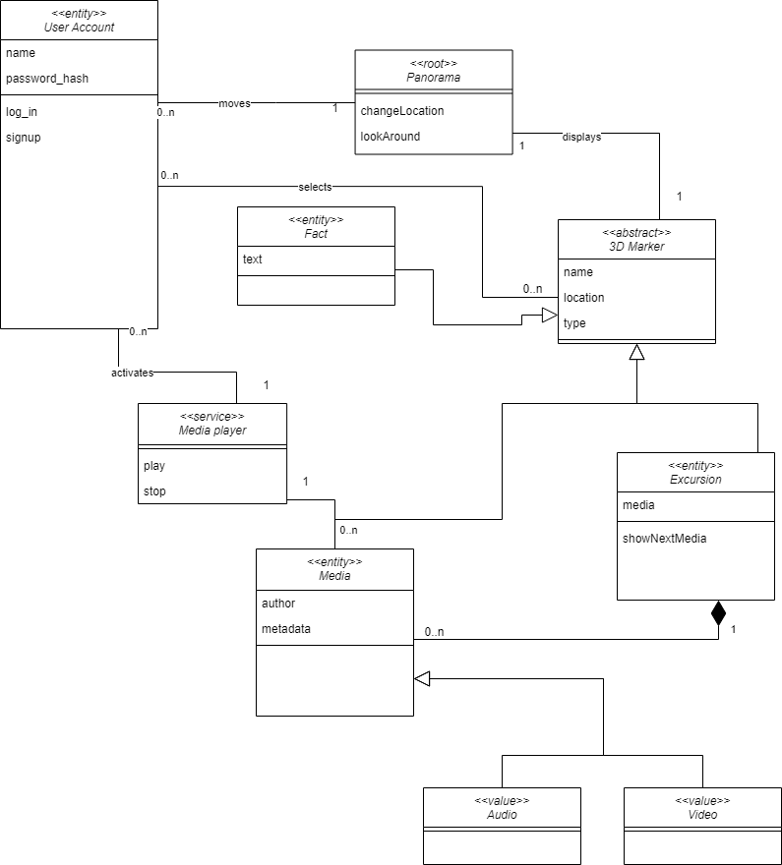
Logical data model - Class diagram for 3D Map Service

Slide 6
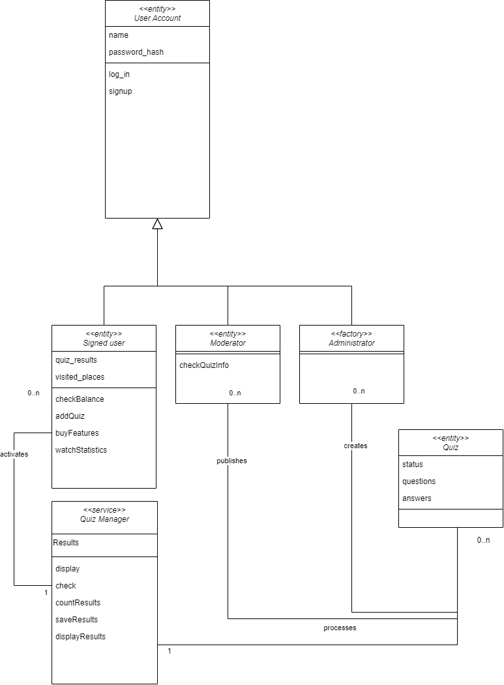
Logical data model - Class diagram for Quiz Manager

Slide 7
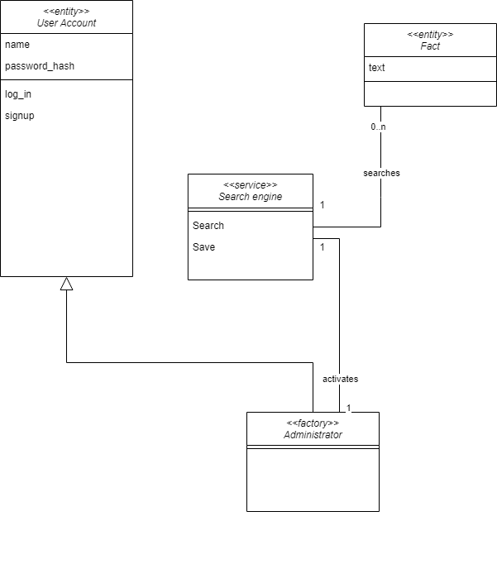
Logical data model - Class diagram for Fact Searcher

Slide 8
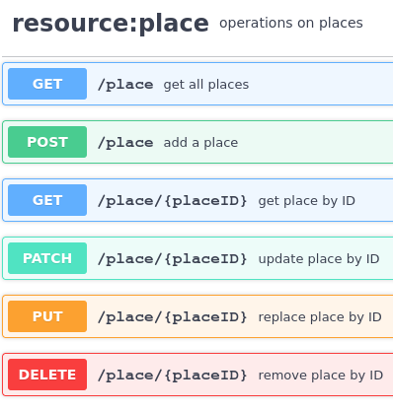
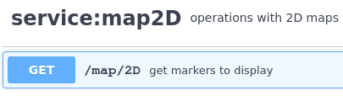
API summary <Map 2D>
On a page map2D - GET /map/2D - get data for markers on 2D map, calls GET /place - (Choose destination) On a page edit_map/2D - GET /place - get all of places that will be displayed on map On a page edit_map/2D - POST /place - add data to 2D map On a page edit_map/2D - PUT /place/{placeID} - modify marker on 2D map On a page edit_map/2D - DELETE /place/{placeID} - remove marker from 2D map

Slide 9
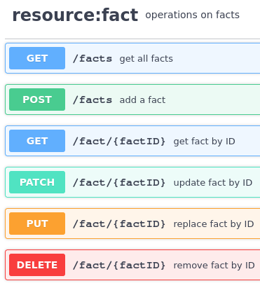
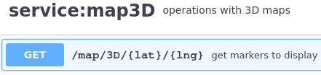
API summary <Map 3D>
On a page map3D - GET /map/3D - get data for markers on 3D map, calls GET /facts, GET /quizes and GET /media and filters out far away markers - (Move in the 3D map) On a page map3D -GET /media/{media_id} - get media to display - (view 3D media of the place) On a page map3D - GET /fact/{fact_id} -get fact to display - (see facts about sights) On a page edit_map/3D - POST /facts - add a new fact On a page edit_map/3D - PUT /fact/{fact_id} - update a fact by id

Slide 10
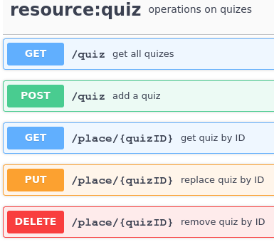
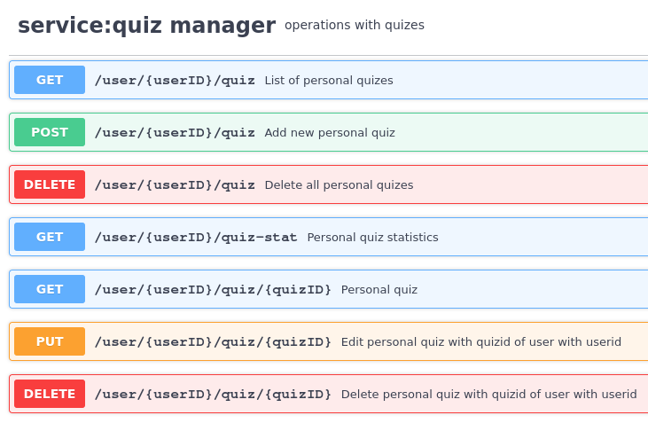
API summary <Quiz Manager>
On a page quiz - GET /quiz - show available quizzes - (solve quizzes) On a page /user/quiz - GET /user/{user_id}/quiz - show personal quizzes On a page /user/quiz - POST /user/{user_id}/quiz - create a new quiz On a page /user/quiz - PUT /user/{user_id}/quiz - update a page On a page /user/quiz - DELETE /user/{user_id}/quiz - remove personal quiz

Slide 11
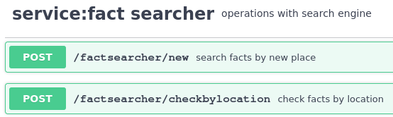
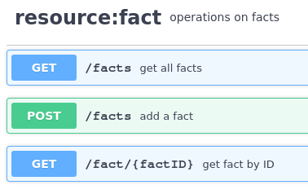
API summary <Fact searcher>
On a page fact_searcher - POST /factsearcher/new - get new facts On a page fact_searcher - POST /factsearcher/checkbylocation - check that facts with the same location doesn’t exists On a page fact_searcher - GET /facts - get list of facts to check for duplicates On a page fact_searcher - POST /facts - add a new fact On a page fact_searcher - GET /fact/{factID} - get info about the fact to check for duplicates

Slide 12
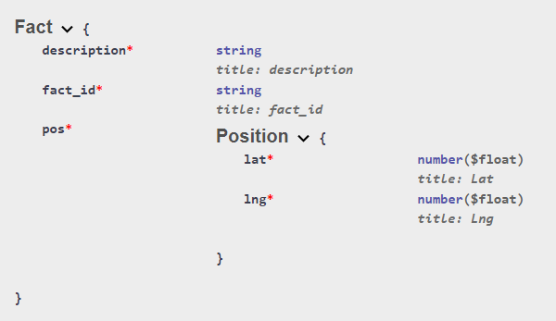
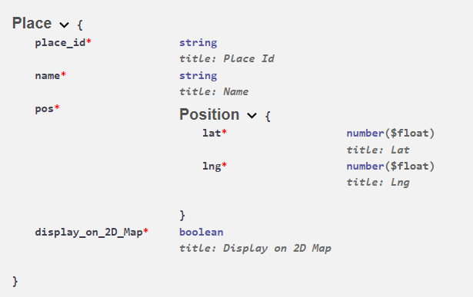
Physical schema for MongoDB (facts+places)
All resources has *_id field of type string as a key of the document. IDs are unique values that can be used to interact with documents. IDs are used by API to execute queries.
As an alternative to *_id field can be used pos. Pos is an object consisting of latitude and longitude values. In all resources this objects are unique that’s why can be used as a primary key.

Slide 13
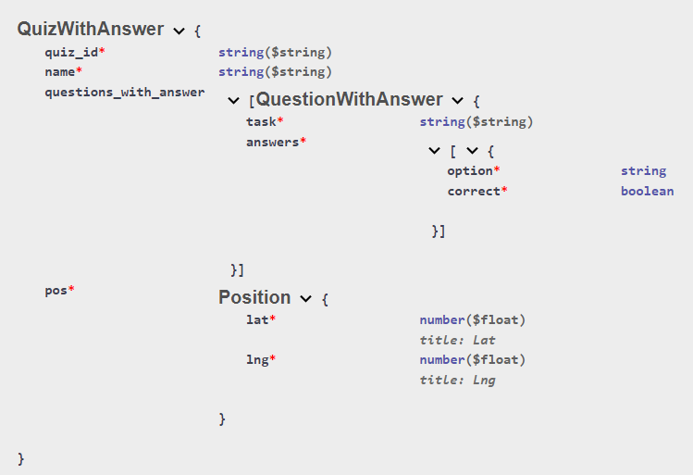
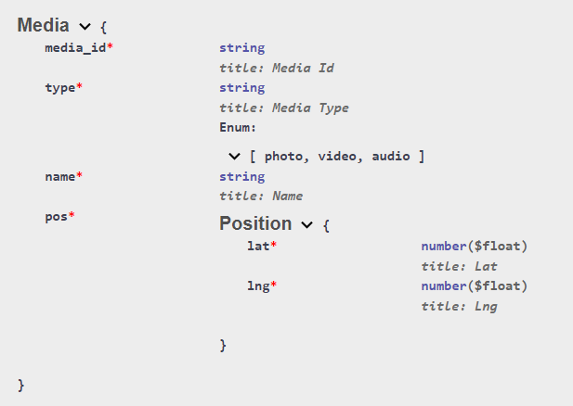
Physical schema for MongoDB (quizzes+media)

Slide 14
Query example for MongoDB (facts)
Facts are searched by fact_id field of type string.
@app.post("/facts", tags=["resource:facts"])
facts_collection.insert_one(fact.dict())
@app.get("/facts/{fact_id}", response_model=Fact, tags=["resource:facts"]) fact = facts_collection.find_one({"fact_id": fact_id})
@app.patch("/facts/{fact_id}", response_model=Fact, tags=["resource:facts"])
result = facts_collection.update_one({"fact_id": fact_id}, {"$set": new_fact_dict})
@app.put("/facts/{fact_id}", response_model=Fact, tags=["resource:facts"])
result = facts_collection.replace_one(
{"fact_id": fact_id},
{"fact_id": fact_id, "name": fact.name, "description": fact.description, "pos": fact.pos.dict()},
)
@app.delete("/fact/{fact_id}", tags=["resource:facts"])
res = facts_collection.delete_one({"fact_id": fact_id})

Slide 15
Team work
Sofya Donskaya - 2D map service
Danil Kireev - 3D map service
Elena Karelina - Quiz manager service
Artem Filimonov - Fact Searcher service

